Slide 1


Cybercrime Against Businesses
Alla Topp
MSDS 640 – Data Ethics

Slide 2

Content
Description / Purpose
Ongoing data gathering
Ethical Issues of the Information Age
Summary findings of the data collected
The types of businesses affected the most
Summary
References

Slide 3
Description/Purpose
Data presents the nature and prevalence of computer security incidents among 7,818 businesses in 2005.
This is the first report to provide data on monetary loss and system downtime resulting from cyber incidents.
It examines details on types of offenders, reporting of incidents to law enforcement, reasons for not reporting incidents, types of systems affected, and the most common security vulnerabilities.
The report also compares in-house security to outsourced security in terms of prevalence of cyber attacks.
The goal of NCSS is to produce reliable national and industry-level estimates of the prevalence of computer security incidents (such as denial of service attacks, fraud, or theft of information) against businesses and the resulting losses incurred by businesses.
Notes:
NCSS - The National Computer Security Survey

Slide 4

Ongoing data gathering
The National Computer Security Survey provides the nation’s first large-scale measure of cybercrime. NCSS documents the nature, prevalence, and impact of cyber intrusions against businesses in the United States. It examines three general types of cybercrime:
Cyber attacks are crimes in which the computer system is the target.
Cyber theft comprises crimes in which a computer is used to steal money or other things of value.
Other computer security incidents encompass spyware, adware, hacking, phishing, spoofing, pinging, port scanning, and theft of other information, regardless of whether the breach was successful.
Notes:
The first national survey of thousands of businesses is being conducted in 2006. It is cosponsored by the Bureau of Justice Statistics and the National Cyber Security Division (NCSD) of the U.S. Department of Homeland Security.

Slide 5



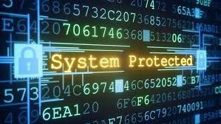

Ethical Issues of the Information Age
Privacy - right of individual to control personal information
Accuracy – who is responsible for the authenticity, fidelity, and accuracy of information?
Property – Who owns the information? Who controls access? (e.g. buying the IP verses access to the IP)
Accessibility – what information does an organization have the right to collect? Under what safeguards?
Transparency – Do the researchers need to get informed consent from the users?
Notes:
Examples of ethical issues:
Tracking employee computer use, managing customer profiles, tracking travel with a national ID card, location tracking (to spam cell phone with text message advertisements)

Slide 6

Statistics
In 2005, among 7,818 businesses
67% detected at least one cybercrime.
Nearly 60% detected one or more types of cyber attack.
11% detected cyber theft.
24% detected other computer security incidents.
Approximately 68% of the victims of cyber theft sustained monetary loss of $10,000 or more.
System downtime lasted between 1 and 24 hours for half of the businesses and more than 24 hours for a third of businesses detecting cyber attacks or other computer security incidents.
The monetary loss for these businesses totaled $867 million in 2005. Cyber theft accounted for more than half of the loss ($450 million). Cyber attacks cost businesses $314 million.

Slide 7

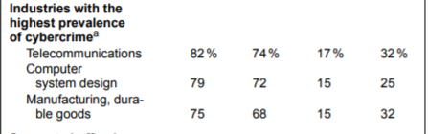
The types of businesses affected the most
Notes:
Refernece: Cybercrime against Businesses, 2005. (n.d.). Retrieved from https://www.bjs.gov/index.cfm?ty=pbdetail&iid=769

Slide 8
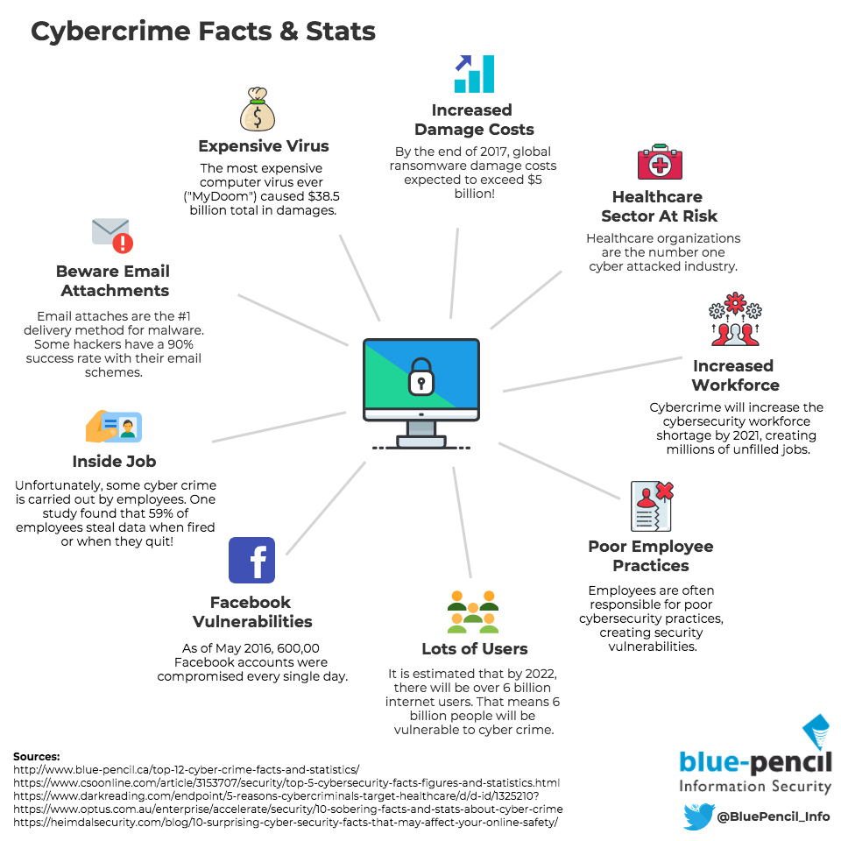
Additional cyber facts and statistics nowadays

Slide 9

Summary
Cybercrime is already a big problem all over the world—and it's growing fast. We can see that a large amount of businesses suffer from cyberattacks every day. NCSS is gathering information on cybercrime and examines it to prevent it from happening. Ethical and privacy issues play a big role in causing cybercrimes because information security is in people`s hands, and it should be a priority among businesses.

Slide 10
References
Cybercrime against Businesses, 2005. (n.d.). Retrieved from https://www.bjs.gov/index.cfm?ty=pbdetail&iid=769

